Slide 1
Predicting Cardiac Wellness: Using a Multi-Layer Perceptron on ECG Data
Benzon Carlitos Salazar

Slide 2
Outline
Introduction
Motivation
Prior Works
Crash Course Anatomy of ECG Signals
Dataset Overview
Methodology
Choice of Algorithm
Data Processing
Feature Extraction
Algorithm Training
Results
Model Evaluation
Conclusion
Challenges Faced
Future Work
Conclusion

Slide 3
Introduction: Motivation
Early detection of heart abnormalities
Automation and efficiency
Objective and consistent analysis
Identification for specific arrhythmias

Slide 4
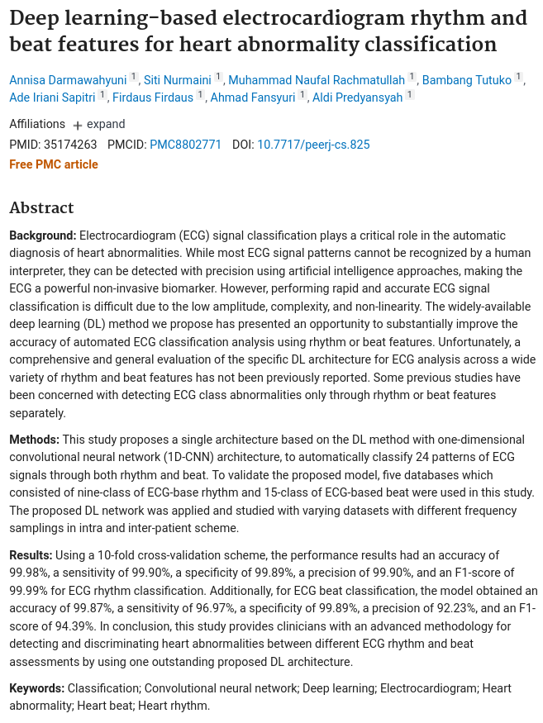
Introduction: Prior Works
[2022] Darmawahyuni, Annisa et al. “Deep learning-based electrocardiogram rhythm and beat features for heart abnormality classification.”
The study addresses a critical issue in cardiovascular health by leveraging deep learning techniques, particularly a one-dimensional Convolutional Neural Network (1D-CNN), for the classification of ECG (Electrocardiogram) patterns based on both rhythm and beat features.
Its contributions lie not only in achieving high accuracy but also in addressing practical considerations such as computational efficiency.

Slide 5
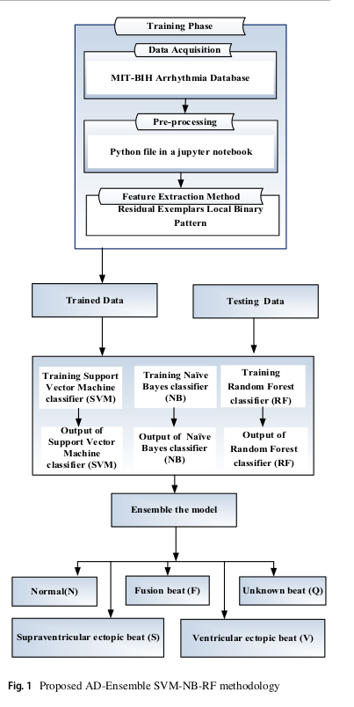
Introduction: Prior Works
[2023] M. Ramkumar et al. “Ensemble classifier fostered detection of arrhythmia using ECG data.”
The study showed a focused approach to cardiac arrhythmia detection, leveraging ensemble classifiers for enhanced accuracy.
The reported improvements in performance metrics underscore the potential significance of the proposed AD-Ensemble SVM-NB-RF method in the field of arrhythmia classification.

Slide 6
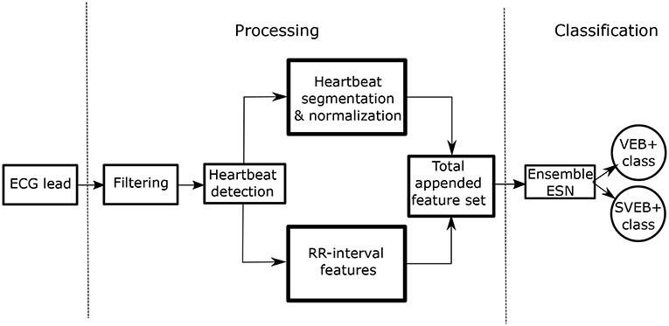
Introduction: Prior Works
[2019] Alfaras Miquel, et al. “A Fast Machine Learning Model for ECG-Based Heartbeat Classification and Arrhythmia Detection”
The study presented a fully automatic and fast ECG Arrhythmia classifier based on ensemble Echo State Networks (ESNs).
The use of the ensemble classifiers allowed them to “exploit parallelism to train the classifiers with remarkable speeds.”

Slide 7
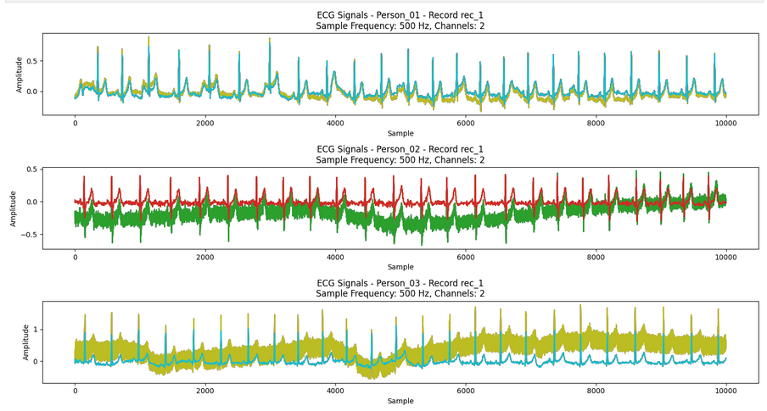
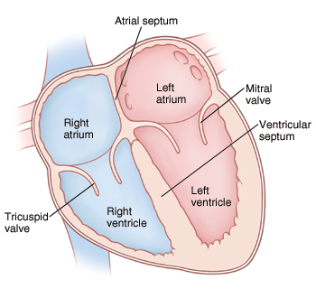
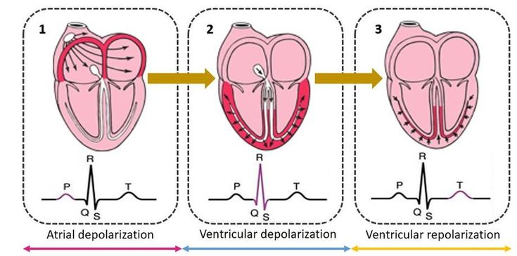
Introduction: Crash Course Anatomy of ECG Signals
ECG = Electrocardiogram
A graph of voltage vs time
ECGs are done to determine the condition of arrhythmias and other heart diseases
The making of any heart rate detection tool is used as preliminary diagnosis of heart health

Slide 8
Introduction: Dataset Overview
MIT-BIH Arrhythmia Dataset
Golden standard to evaluate arrhythmia classifiers
48 half-hour ECG records sampled at 360 Hz (60 hours worth of ECG data)
Contains two leads
Have annotations indicating the class of the heartbeat and its position verified by experts and clinicians
Example: https://github.com/carrliitos/ecg_classification/blob/master/notebooks/a01_view_mitdb_data.ipynb

Slide 9
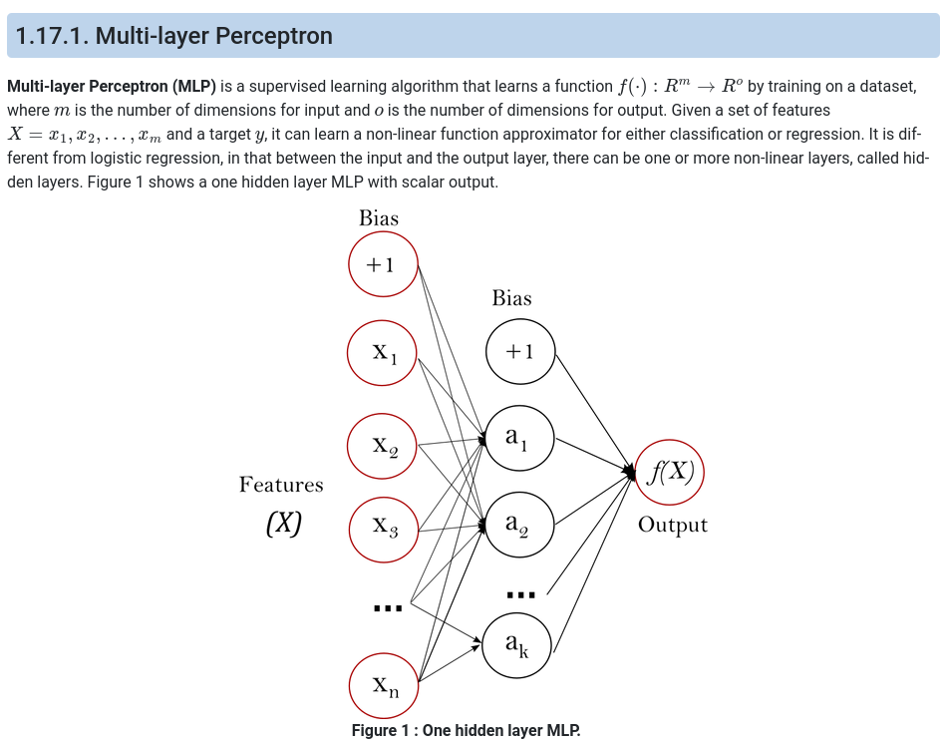
Methodology: Choice of Algorithm
Deep Neural Network (DNN) vs Multilayer Perceptron (MLP)
Multilayer Perceptron
Non-linear mapping
Feature Learning
Adaptability
Scalability

Slide 10
Methodology: Choice of Algorithm: Multilayer Perceptron
Supervised Learning
Function Approximation
Non-linear Function Approximator
Comparison with Logistic Regression

Slide 11
Methodology: Choice of Algorithm: Multilayer Perceptron
Optimization Algorithms
Stochastic Gradient Descent
Adam Optimizer
L-BFGS Solver

Slide 12
Methodology: Data Processing
Download MIT-BIH Arrhythmia Database
Download MIT-BIH Arrhythmia Database from PhysioNet
Convert WFDB files to CSV
Split at R-peaks
Read QRS Complex
Resample at 125 Hz to standardize the data
Normalize mV readings to 0-1 range
Discard erroneous values
Reduce classifications to Normal/Abnormal
Generate Training, Validation, and Test CSV files via random shuffling
60% of the records are in Training
20% of the records are in Validation
20% of the records are in Testing
Train, Validate, and Test the model
Convert WFDB files to CSV files
Generate Training, Validation, and Test CSV files
Train, Validate, and Test Model

Slide 13
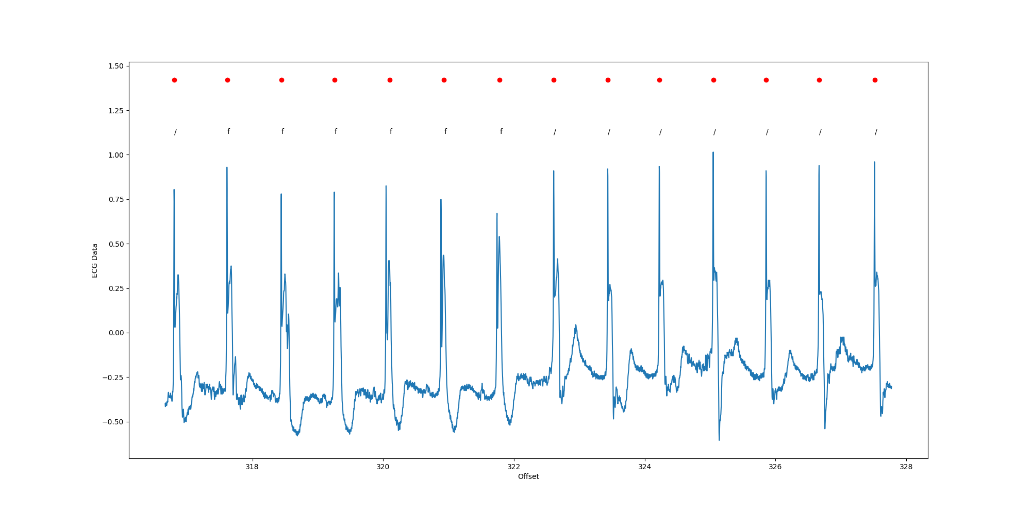
Methodology: Data Processing

Slide 14
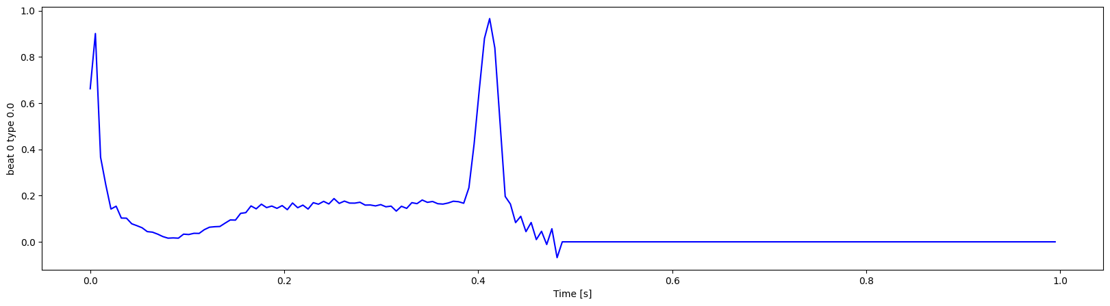
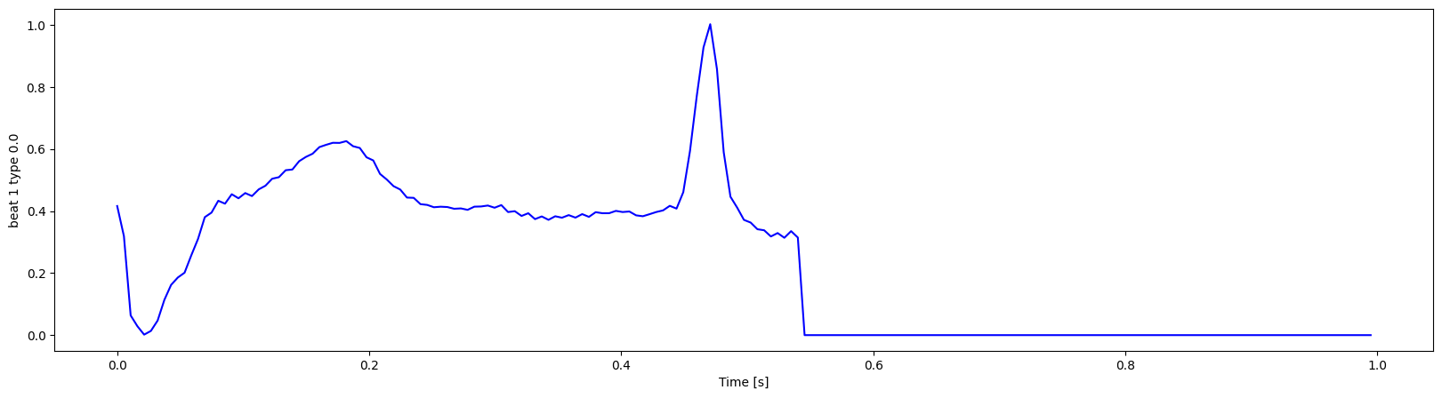
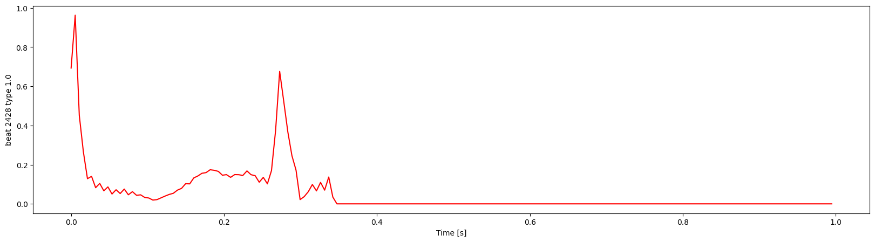
Methodology: Feature Extraction
R-peak detection
Instead of using annotations to find the beats, R-peak detection was used instead.
Annotations are then used to classify the beat as Normal or Abnormal. (https://physionet.org/physiobank/database/html/mitdbdir/intro.htm)
Heartbeat classifications from the annotations is reduced to just Normal and Abnormal and appended to the end of each heartbeat record (0 is normal, 1 is abnormal) (https://github.com/carrliitos/ecg_classification/blob/master/notebooks/a02_import_mitdb_data.ipynb)

Slide 15
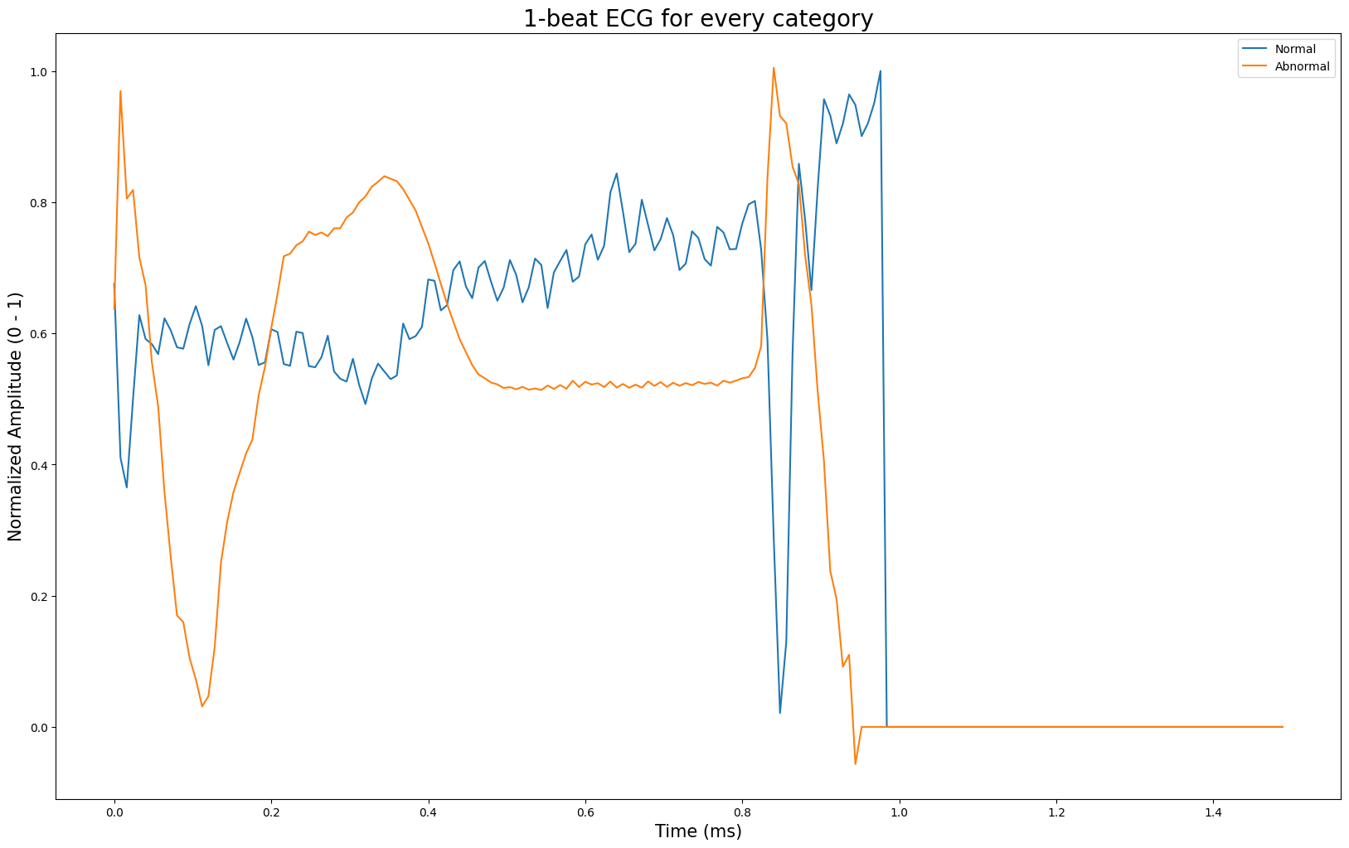
Methodology: Algorithm Training
Training using Multilayer Perceptron

Slide 16
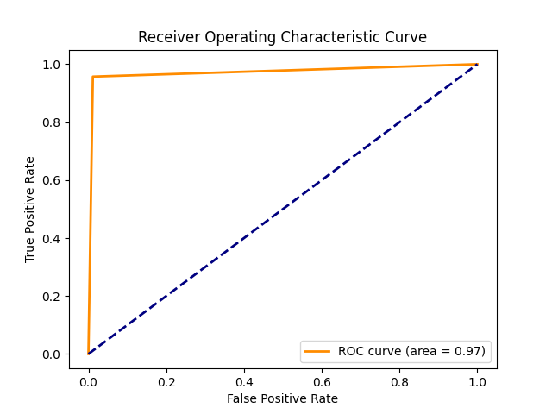
Model Evaluation
Validation Phase
Test Accuracy: 98.09%
Precision: 98.87%
Recall: 98.60%
Specificity: 95.71%
F1 Score: 98.73%
 |  | Actual
 |  | Positive | Negative
Predicted | Positive | 22255 | 255
 | Negative | 316 | 7045

Slide 17
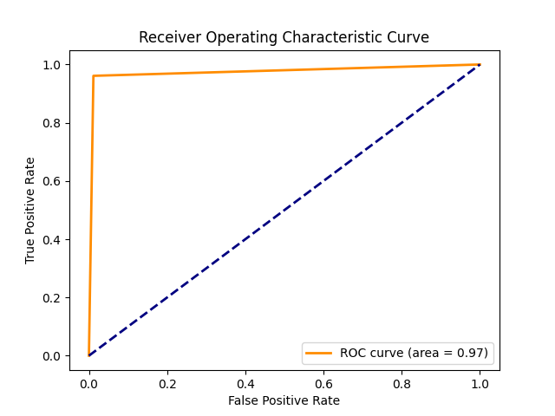
Model Evaluation
Testing Phase
Test Accuracy: 98.18%
Precision: 98.85%
Recall: 98.73%
Specificity: 96.11%
F1 Score: 98.79%
 |  | Actual
 |  | Positive | Negative
Predicted | Positive | 22244 | 258
 | Negative | 287 | 7083

Slide 18
Challenges Faced
ECG-ID Database Limitations
Lack of labeled data and annotations
Unfamiliarity with EG Data Processing and Interpretation
Relatively high learning curve in understanding the waveform signals
Complexity of ECG Data
Inherent noise and complexity of EG data posed a challenging PQRST wave identification
Hardware Limitations
TensorFlow vs Scikit-Learn

Slide 19
Future Work
Integration of TensorFlow and PyTorch
Extended Dataset Duration
Incorporating a more recent dataset (2020 - Current)
Ensemble Learning Approaches

Slide 20
Conclusion
Remarkable Performance Metrics
Achieved accuracy of 98%
High Confidence in Predictive Accuracy
Predictive Potential

